Slide 1

Intersectionality in ML Classification
02/10/2025 - Chiara Criscuolo
Notes:
Presentazione talk + speaker

Slide 2
Fairness Issues
Research directions:
consider multiple protected attributes
consider protected-attributes that are no-binary
consider intersectional bias
consider intersectional bias with no-binary protected attributes
consider non-binary target class

Slide 3
Intersectional vs Multiple Attribute
Multiple attribute problem: given Race= {A,B}, Age= {𝛼, β} and Sex={0,1} → We (should) compare:
A vs B
𝛼 vs β
0 vs 1
Intersectional problem: given Race= {A,B} and Sex={0,1} → We (should) compare:
(A,0) vs (A,1)
(A,0) vs (B,0)
(A,0) vs (B,1)
(A,1) vs (B,0)
(A,1) vs (B,1)
(B,0) vs (B,1)

Slide 4
Intersectional vs Multiple Attributes
We can consider the multiple attribute problem as a specialization of the intersectionality problem.
Intersectionality
Multiple attributes

Slide 5
Intersectionality metrics

Slide 6
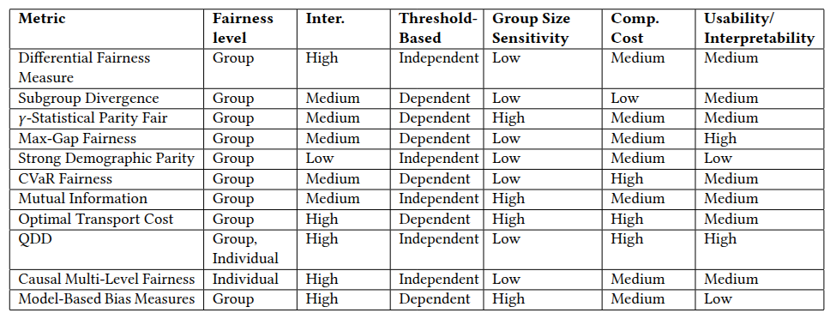
State-of-the-art metrics

Slide 7
State-of-the-art metrics
not presented here because they are not statistical

Slide 8
General Approaches for Intersectionality
Approach #1: Compare a specific group X pair-wise with the other groups
Approach #2: Compare a specific group X with an aggregator (ALL - X)
Approach #3: Compare a specific group X with a weighted aggregator (ALL - X)
Approach #4: Compare a specific group X with the max-difference group

Slide 9

Differential Fairness Measure
It measures if the probability of a positive prediction is similar across all subgroups, so this definition is a natural extension of demographic parity in the setting of multiple subgroups.
Notice that this definition can also be used for other fairness notions, such as equal opportunity.
In fact, given 𝛼 possible subgroups compared pairwise (𝛽 = 2), the problem has combinatorial dimensionality, the total number of comparisons are computed as
(𝛼)!/((𝛽 )!(𝛼 −𝛽 )!) = (𝛼 )!/(2!(𝛼 −2)!)

Slide 10

Subgroup Divergence
It compares the performance difference between one subgroup and the overall
dataset. Additionally, subgroup divergence does not downweight small subgroups.
Divergence saves complexity by not comparing each subgroup combination but only comparing the performance 𝑓 (𝑔) for one subgroup with the whole dataset 𝑓 (𝐷).
The divergence values for every subgroup can then be combined using a cumulative operator ⊙ like sum or max.

Slide 11
𝛾- Statistical Parity Fair
The notion of 𝛾- statistical parity fair is a specification of divergence.
The difference is that this is a threshold-based definition and small subgroups are weighted down, so a low percentage of positive predictions for a small subgroup is not as crucial as for a big subgroup.
𝛾 is a user-chosen hyper-parameter and to choose a reasonable 𝛾 is an important task.

Slide 12
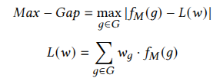
Max-Gap Fairness
The Max-Gap fairness is also a specification of subgroup divergence where they choose ⊙ to be the maximum operator.
Additionally, instead of directly computing the model performance on the whole dataset, they calculate it as the average weighted subgroup performance.
The flexible weights 𝑤𝑔 allow the user to manually adjust the importance of subgroups.

Slide 13
Strong Demographic Parity
The Strong Demographic Parity evaluates if the probability that one sensitive group has a higher score than the others.
Given a group 𝑆+ it is compared with all the others (𝑆−) in an aggregated way.

Slide 14

CVaR Fairness
This notion of fairness is motivated by the problem that Max-Gap Fairness only focuses on the worst-performing subgroup. This metric focuses on the worst performing set of subgroups, 𝑄𝛼 ⊆ 𝐺 is a set representing the worst performing groups.
The challenge of this approach is the (efficient) identification of this set. Simply testing all subgroups and then collecting the worst-performing subgroups will also lead to the problem of an exponentially increasing amount of subgroups. The paper addresses this challenge and proposes an effective ways (weighted sampling and attribute specific sampling) to approximate this set.

Slide 15

Mutual Information
Mutual Information (MI) is a concept from information theory that measures how much information one random variable shares with another.
This definition can be used to measure the dependence between the prediction outcomes and sensitive attributes.
A classifier that satisfies fairness metrics such as statistical parity also minimizes the mutual information between the sensitive attributes and the model’s predictions.
Therefore the goal is to build the vector s = [𝑠 (1) , ..., 𝑠 (𝑘 ) ] where each 𝑠 ( 𝑗 ) corresponds to a sensitive attribute and try to minimize 𝐼 ( ˆ𝑦, s), for statistical parity.

Slide 16

Optimal Transport Cost
Distribution-based bias measure that tries to project the observed outcome distribution onto a group fair distribution.
The goal is to minimize the Wasserstein Distance, such that the source and target distributions match.
The Wasserstein-1 distance 𝑊1 (𝑃, 𝑄) between two probability distributions 𝑃 and 𝑄 is hereby given by the formula where Γ(𝑃, 𝑄) is the set of probability distributions with marginals 𝑃 and 𝑄; for a given value 𝑥, 𝑃 (𝑥) gives the probability of 𝑃 at position 𝑥.

Slide 17

QDD
It is a novel formulation of the Wasserstein-1 distance metric. It is originally designed for continuous fairness monitoring but can also be used as a
standard subgroup or individual fairness metric.
The first step is to segment the prediction scores of the subgroups into 𝐵 quantile bins. For example, if we have 𝐵 = 4, we segment the scores into four bins 𝑏1, 𝑏2, 𝑏3, 𝑏4, where 𝑏1 contains the tuples with the lowest 25% scores, 𝑏2 contains the tuples where the scores fall in the 25% − 50% range, and so on.
The QDD metric is defined for a bin 𝑏 and two subgroups 𝐺1, 𝐺2 as in the formula.

Slide 18
General Approaches for Intersectionality
Approach #1: Compare a specific group X pair-wise with the other groups→ complexity issue

Slide 19
Overall Complexity
How many combinations:
n: number of groups
m: cardinality of the comparison (in this case is 2 for pair-wise comparison)
Formula: n!/(m!*(n-m)!)
For example, if n=3, m=2 → (3!) / ( 2! * (3-2)! ) = 3
if n=5, m=2 → (5!)/(2!*(5-2)!) = 5*4 = 20

Slide 20
General Approaches for Intersectionality
Approach #1: Compare a specific group X pair-wise with the other groups
Approach #2: Compare a specific group X with an aggregator (ALL - X) → an aggregator as avg does not catch the inequalities correctly

Slide 21
Fair Example
Ŷ=1: predicted to have the credit
(Ŷ=1 |G’=black) = 0.6
(Ŷ=1 |G’=white) = 0.8
(Ŷ=1 |G’=asian) = 0.7
Group Fairness = 𝜠((0.6/0.8) + (0.6/0.7) + (0.7/0.8)) = 𝜠(0.75 + 0.85 +0.875) = 0.83
ALGORITHM FAIR!

Slide 22
General Approaches for Intersectionality
Approach #1: Compare a specific group X pair-wise with the other groups
Approach #2: Compare a specific group X with an aggregator (ALL - X)
Approach #3: Compare a specific group X with a weighted aggregator (ALL - X) → small subgroups are weighted down, so a low percentage of positive predictions for a small subgroup is not as crucial as for a big subgroup

Slide 23
General Approaches for Intersectionality
Approach #1: Compare a specific group X pair-wise with the other groups
Approach #2: Compare a specific group X with an aggregator (ALL - X)
Approach #3: Compare a specific group X with a weighted aggregator (ALL - X)
Approach #4: Compare a specific group X with the max-difference group

Slide 24
Basic idea
G: ethnicity = {white, black, asian, hispanic}
Group Fairness_g = GF_g = (Ŷ=1 |G=g) computed for each value g in G
Each value can be the score of the group in a ranking R (given one ML model)
R = [ GF_w, GF_a, GF_b, GF_h] in descending order
Group Fairness_overall = max(R)-min(R) (subtraction approach)
Group Fairness_overall = min(R)/min(R) (division approach)

Slide 25
Toy Example
G: ethnicity = {white, black, asian, hispanic}
Group Fairness_w =GF_w = 0.9, GF_b = 0.5, GF_a = 0.7, GF_h=0.2
R =[0.9, 0.7, 0.5, 0.2] in descending order
Group Fairness_overall = max(R)-min(R) = 0.9-0.2 = 0.7 (UNFAIR)
Group Fairness_overall = min(R)/max(R) = 0.2/0.9 = 0.22 (UNFAIR)
This can be done with the majority of statistical fairness metrics!

Slide 26
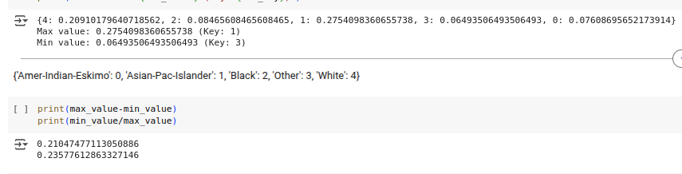
Hands-on using US Census Dataset
Regarding Group Fairness, the best group is the Asian one, and the worst one is the ‘Other race’
Group Fairness overall is around 0.22

Slide 27
Basic idea
G: ethnicity= {white, black}
Group Fairness = (Ŷ=1 |G=black)/(Ŷ=1 |G=white) ≅ black/white
G’: ethnicity = {white, black, asian}
Group Fairness = 𝜠( (Ŷ=1 |G’=black)/(Ŷ=1 |G’=white) + (Ŷ=1 |G’=black)/(Ŷ=1 |G’=asian) + (Ŷ=1 |G’=asian)/(Ŷ=1 |G’=white) )
≅ (black/white + black/asian + asian/white)/3

Slide 28
Unfair Example (only one group)
Ŷ=1: predicted to have the credit
(Ŷ=1 |G’=black) = 0.4
(Ŷ=1 |G’=white) = 0.8
(Ŷ=1 |G’=asian) = 0.7
Group Fairness = 𝜠((0.4/0.8) + (0.4/0.7) + (0.7/0.8)) = 𝜠(0.5 + 0.57 +0.875) = 0.65
ALGORITHM NOT FAIR!

Slide 29
Unfair Example (more than one group)
Ŷ=1: predicted to have the credit
(Ŷ=1 |G’=black) = 0.4
(Ŷ=1 |G’=white) = 0.8
(Ŷ=1 |G’=asian) = 0.5
Group Fairness = 𝜠((0.4/0.8) + (0.4/0.5) + (0.5/0.8)) = 𝜠(0.5 + 0.8 +0.625) = 0.64
ALGORITHM NOT FAIR!

Slide 30
Fair Example
Ŷ=1: predicted to have the credit
(Ŷ=1 |G’=black) = 0.6
(Ŷ=1 |G’=white) = 0.8
(Ŷ=1 |G’=asian) = 0.7
Group Fairness = 𝜠((0.6/0.8) + (0.6/0.7) + (0.7/0.8)) = 𝜠(0.75 + 0.85 +0.875) = 0.83
ALGORITHM FAIR!

Slide 31
Note
Each ratio should be maximum 1 otherwise you should invert the ratio → the discriminated group should be ALWAYS the numerator
With this computation we can create a fairness priority list, in the examples:
Group Fairness= 𝜠((0.4/0.8) + (0.4/0.7) + (0.7/0.8)) = 𝜠(0.5 + 0.57 + 0.875) = 0.65
White >>> Asian >>> Black
Group Fairness = 𝜠((0.4/0.8) + (0.4/0.5) + (0.5/0.8)) = 𝜠(0.5 + 0.8 + 0.625) = 0.64
White >>> Asian >>> Black

Slide 32
Intersectionality examples

Slide 33


Different aggregation functions
Given 2 groups g1 and g2 and the probabilities:
P(Y=1)
P(Y=1|g=G) where g= {g1, g2} and G is the domain of g
We have different aggregation functions to compute P(Y=1|g1=B, g2=D)
Independence approach |  | g1 and g2 should be independent
Harmonic Mean |  | it should penalize low probabilities
Geometric Mean |  | g1 and g2 considered independent
Subtraction Approach |  | it works when g1 and g2 are moderately dependent
Arithmetic Mean

Slide 34
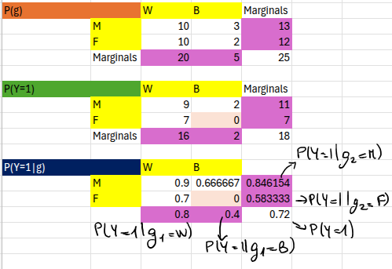
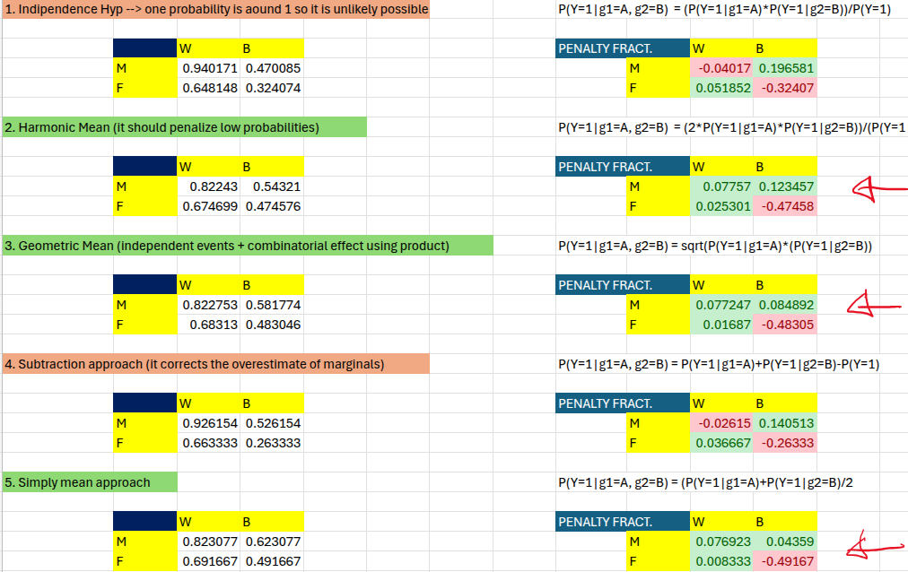
Example with 2x2 values

Slide 35
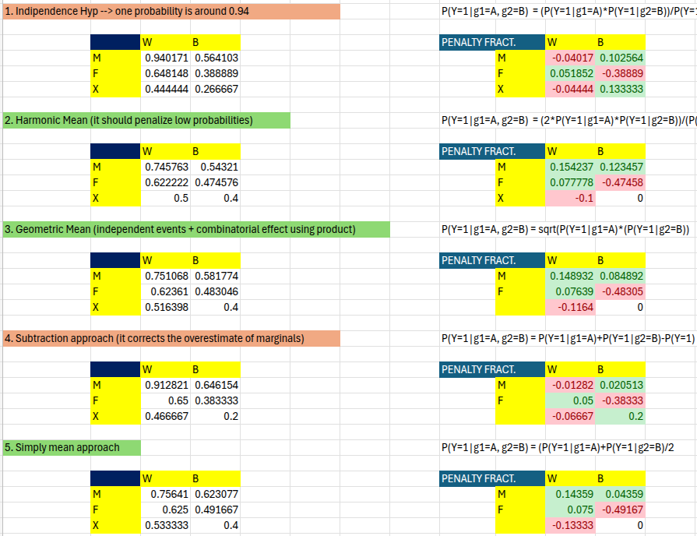
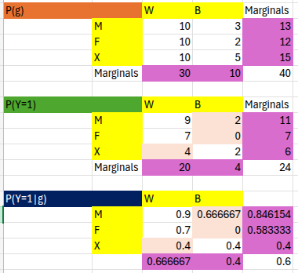
Example with 3x2 values

Slide 36
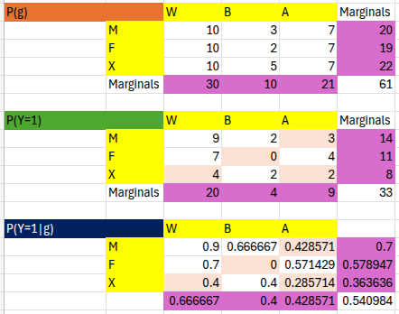
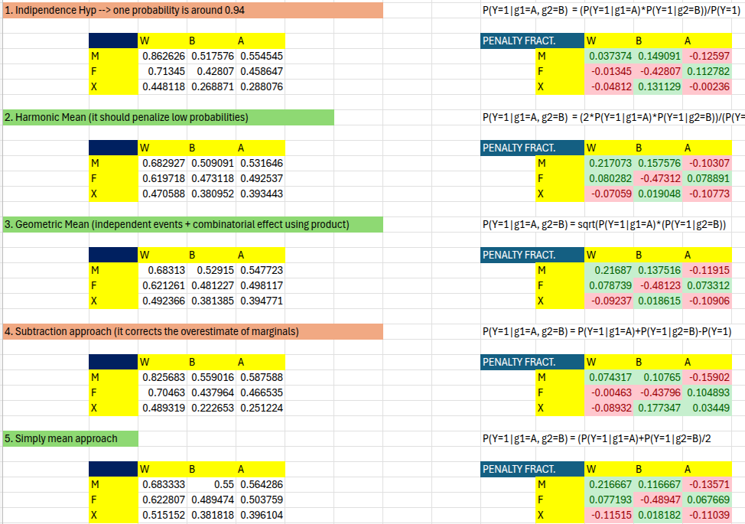
Example with 3x3 values

Slide 37

Comparing the aggregation functions
Harmonic, Geometric and Arithmetic Mean show the same behaviours.
The harmonic formula
assigns greater weight to smaller values. If either value is very small, the harmonic mean result will be closer to that value than the arithmetic or geometric mean.
Independence approach |  | g1 and g2 should be independent
Harmonic Mean |  | it should penalize low probabilities
Geometric Mean |  | g1 and g2 considered independent
Subtraction Approach |  | it works when g1 and g2 are moderately dependent
Arithmetic Mean

Slide 38
Intersectionality on Census US Dataset

Slide 39
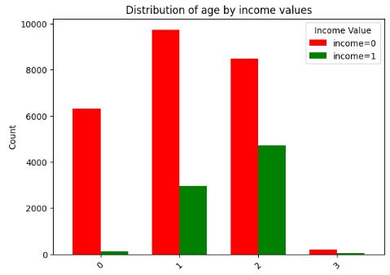
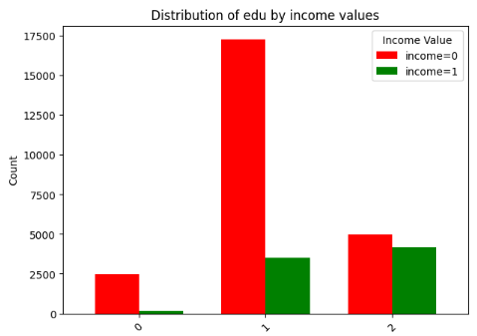
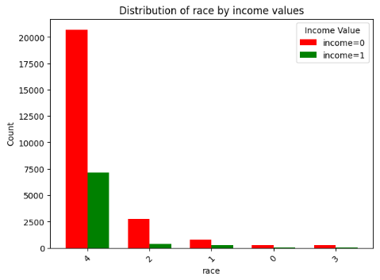
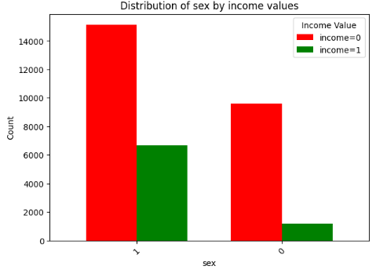
Distribution Analysis: Not-Binary Census
'age':{
0: '11>age> 25',
1: '25>age>40',
2: '40>age>75',
3: '75>age>90'
},
'edu':{
0: '1>edu>6',
1: '6>edu>11',
2: '11>edu>16'
},
'sex':{
0: 'female',
1: 'male'
},
'race':{
0: 'Ame-Ind-Esk',
1: 'Asi-Pac-Isl',
2: 'Black',
3: 'Other',
4: 'White'
}

Slide 40
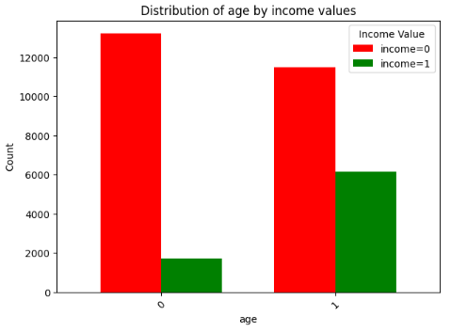
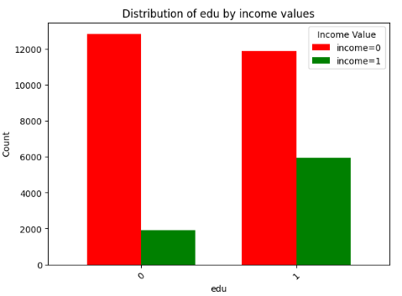
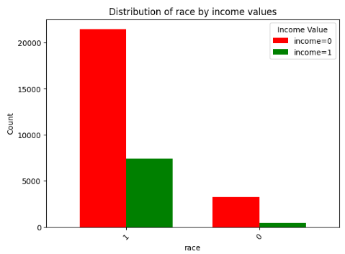

Distribution Analysis: Binary Census
'age':{
0: 'age<35',
1: 'age>35'
},
'edu':{
0: 'edu<9',
1: 'edu>9'
},
'sex':{
0: 'female',
1: 'male'
},
'race':{
0: 'Ame-Black-Other',
1: 'Asian-White'
}

Slide 41
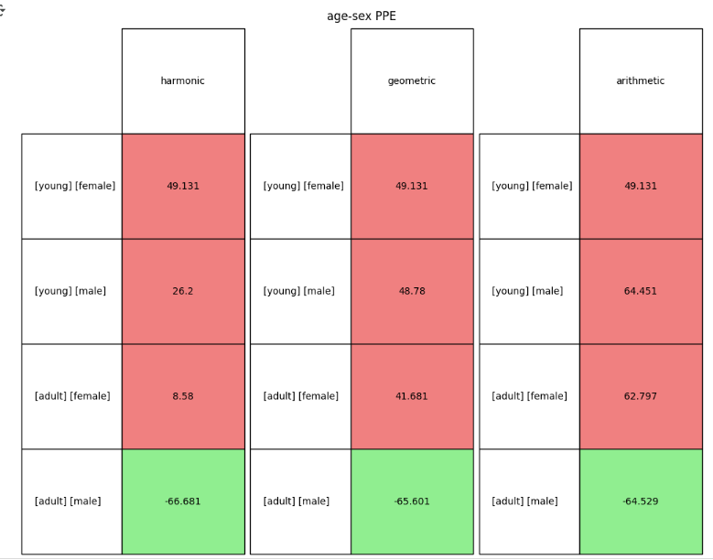
2-combinations Census US (Binary)
PPE = (FP)/(TN+FP)

Slide 42
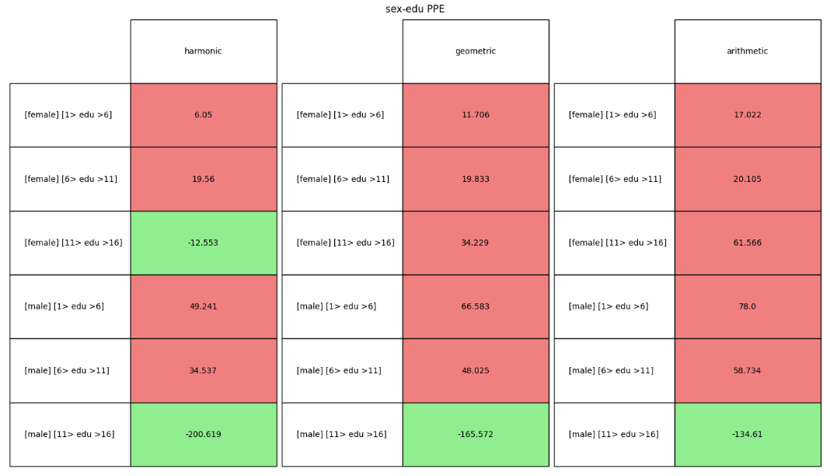
2-combinations Census US (Not Binary)
PPE = (FP)/(TN+FP)

Slide 43
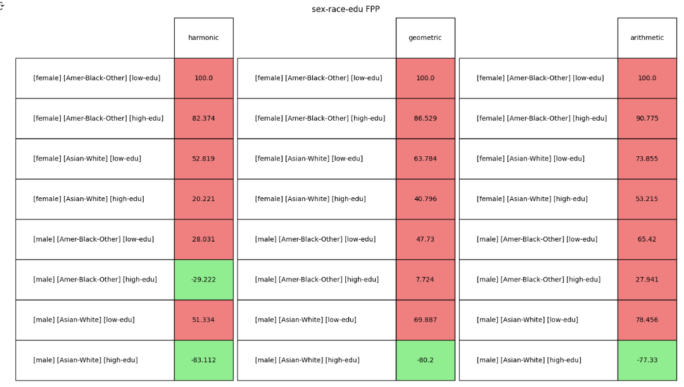
3-combinations Census US (Binary)
FPP= (FP)/|group|

Slide 44
Intersectionality on Compas Dataset

Slide 45
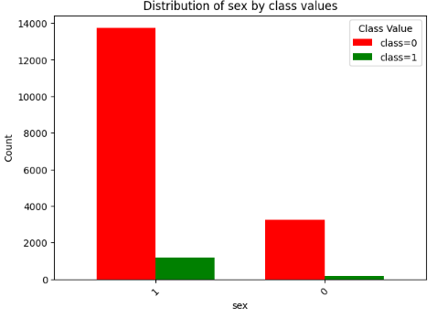
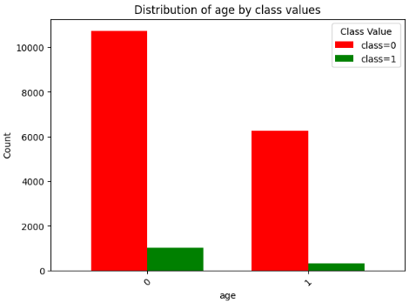
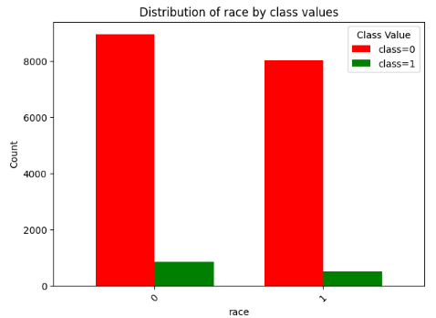
Distribution Analysis: Binary Compas
'age':{
0: 'age<35',
1: 'age>35'
},
'sex':{
0: 'female',
1: 'male'
},
'race':{
0: 'African',
1: 'Asian-White-Hisp-Nat-Other'
}

Slide 46
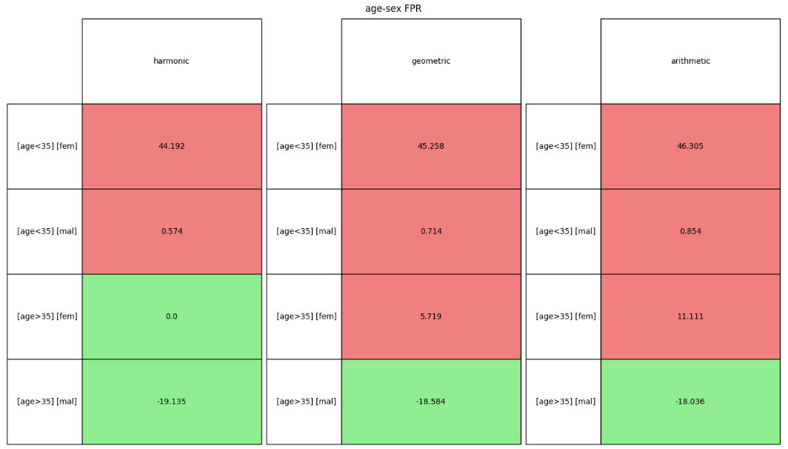
2-combinations Compas (Binary)
FPR= (FP)/(TP+FP)

Slide 47
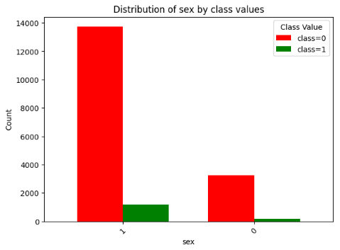
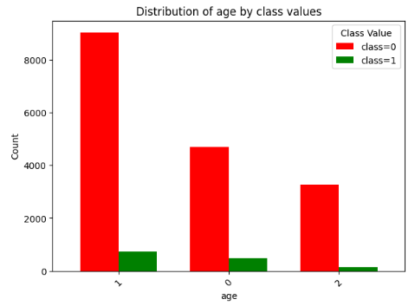
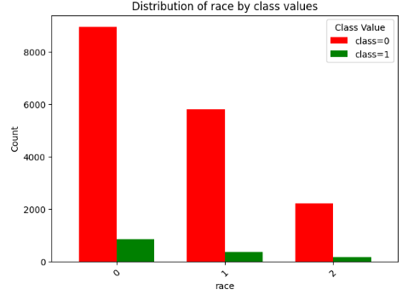
Distribution Analysis: Not-Binary Compas
'age':{
0: 'age<25',
1: '25>age>45',
2: 'age>45'
},
'sex':{
0: 'female',
1: 'male'
},
'race':{
0: 'African',
1: 'Asian-White',
2: 'Hisp-Nat-Other'
}

Slide 48
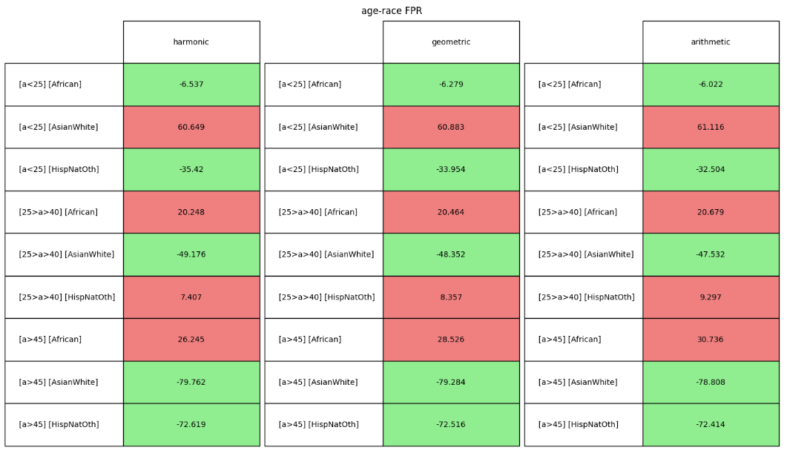
2-combinations Compas (Not Binary)
FPR= (FP)/(TP+FP)

Slide 49
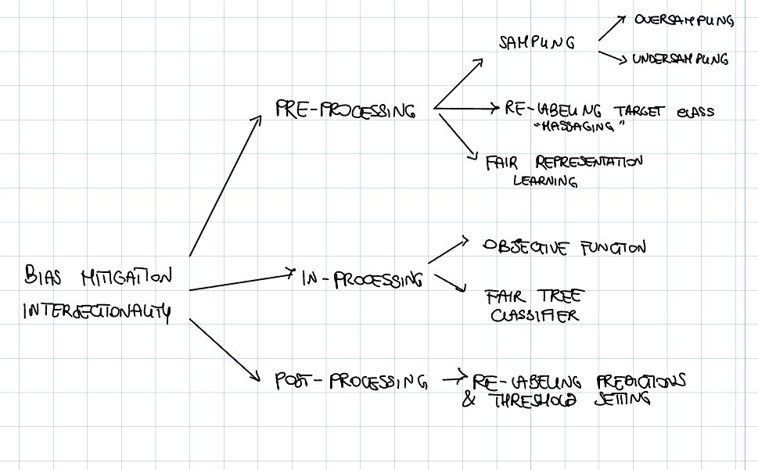
Bias mitigation categories

Slide 50
Result presentation & search approach

Slide 51
Todo:
To present the results:
Motivate the aggregation function ✅
Decide the right fairness metric
Decide which configuration (dataset - attributes)
To improve the penalty computation:
Discard useless configurations ✅
Try to find a greedy approach to find penalized groups

Slide 52
The right fairness metric
In both datasets (Compas and Adult Census) there is a binary target class in which the class 0 is much greater than the class 1 → thus our focus should be on FP measures:
if FP!=0:
if m=='PPE':
fairness_metric = (FP)/(TN+FP) #PredictiveEquality or FalsePositiveRate (FPR)
elif m=='FPR':
fairness_metric = (FP)/(TP+FP) #FalsDiscoveryRate
elif m=='FPP':
fairness_metric= (FP)/len_group #FalsePositiveParity
elif m=='FPN':
fairness_metric= (FP)/(FN+FP)

Slide 53
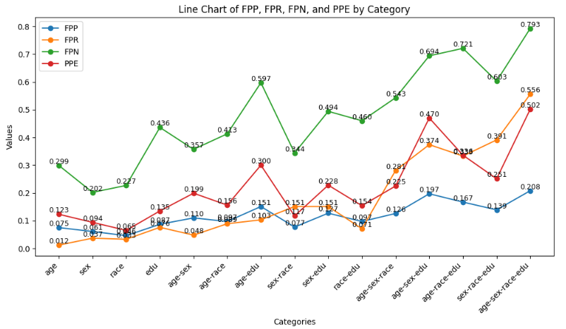
The right fairness metric
'PPE' = (FP)/(TN+FP)
#PredictiveEquality or
FalsePositiveRate (FPR)
'FPR' = (FP)/(TP+FP)
#FalsDiscoveryRate
'FPP' = (FP)/len_group
#FalsePositiveParity
'FPN' = (FP)/(FN+FP)

Slide 54
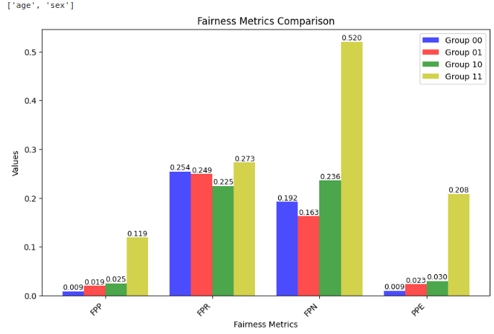
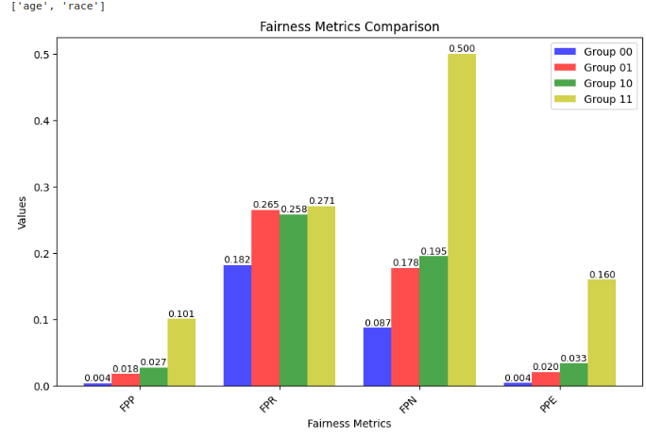
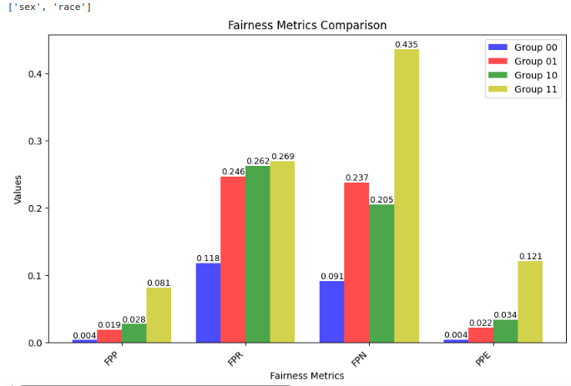
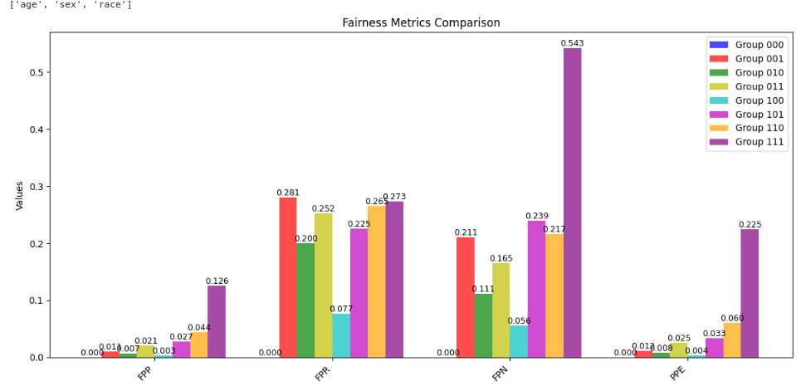
'PPE' = (FP)/(TN+FP)
#PredictiveEquality or
FalsePositiveRate (FPR)
'FPR' = (FP)/(TP+FP)
#FalsDiscoveryRate
'FPP' = (FP)/len_group
#FalsePositiveParity
'FPN' = (FP)/(FN+FP)

Slide 55


Slide 56
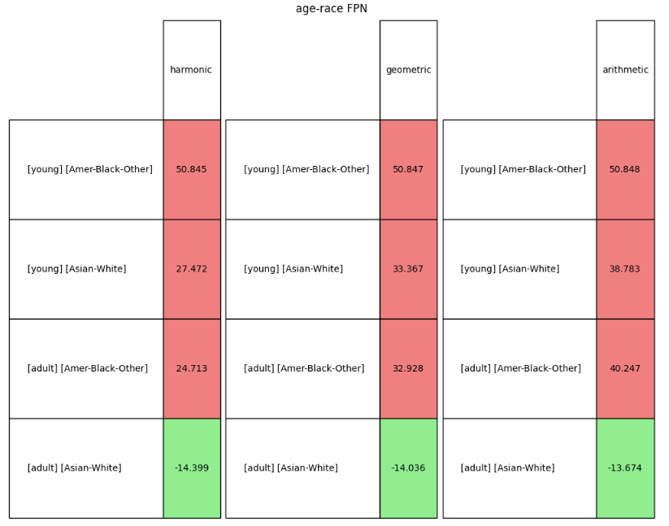

Slide 57
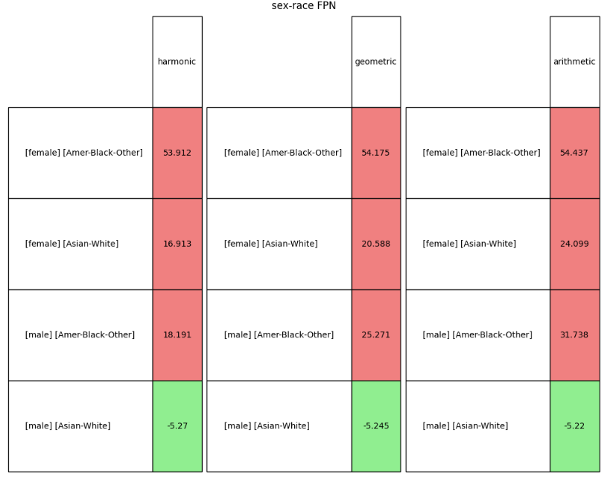

Slide 58
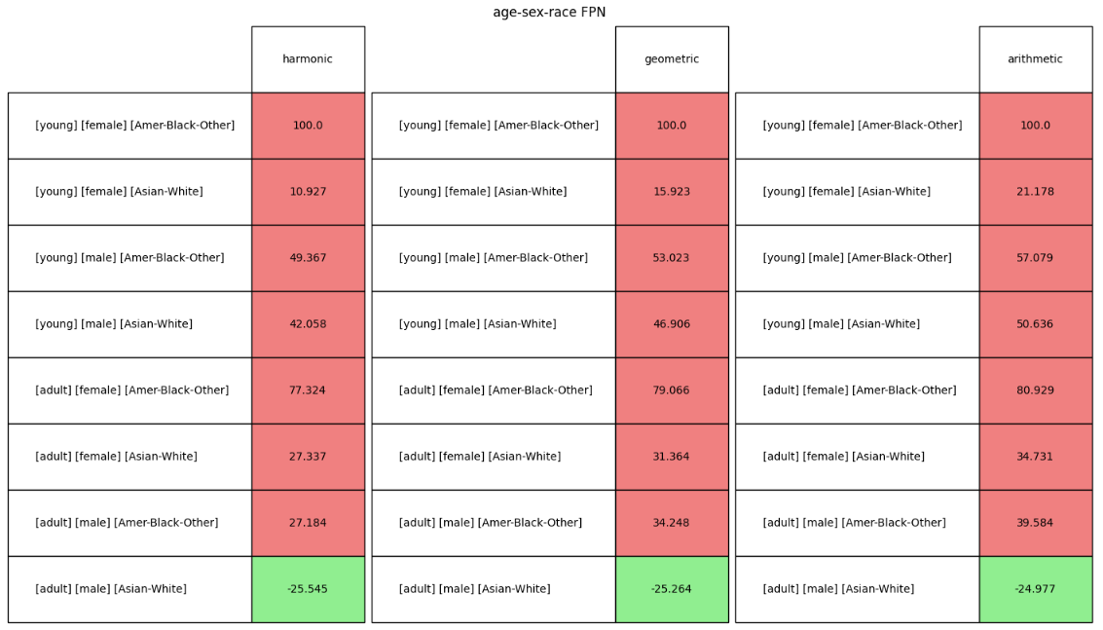

Slide 59
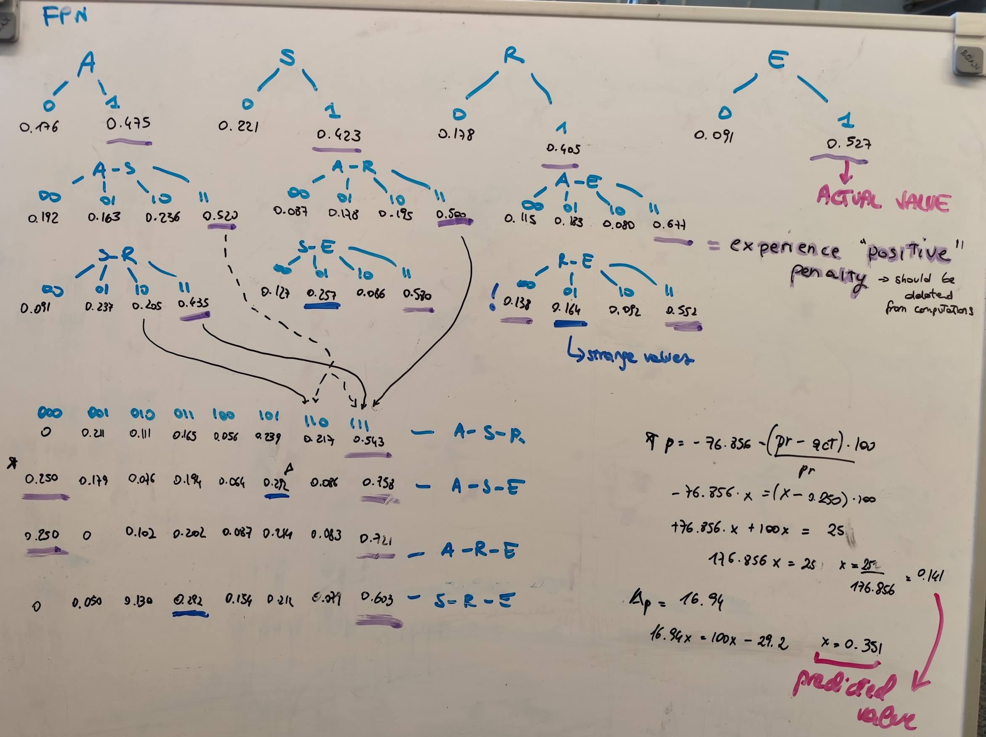
Greedy
approach

Slide 60
Problem Statement

Slide 61
Problem Statement
Given a dataset D with N protected attributes and a set G of all possible subgroups, for a binary classification task,
DISCOVER AUTOMATICALLY all surprising penalized/favored subgroups:
in linear complexity O(N*G) → (could be O(N+1)?)
with ML-model agnostic way
giving a easily understandable and interpretable motivation
without being constrained to any specific statistical fairness metric.
AND MITIGATE THEM …

Slide 62
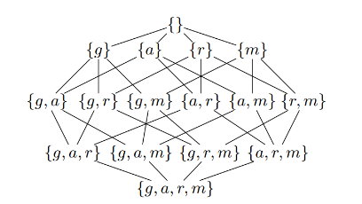
Problem Statement
Given a dataset D with N protected attributes and a set G of all possible subgroups, for a binary classification task,
DISCOVER AUTOMATICALLY all surprising penalized/favored subgroups:
in linear complexity O(N*G)
with ML-model agnostic way
giving a easily understandable and interpretable motivation
without being constrained to any specific statistical fairness metric.

Slide 63

Mitigation: reweight approach
To reduce intersectional unfairness in binary classification by assigning higher training weights to samples from underprivileged subgroups.
Input:
A dataset,
Precomputed penalty scores per subgroup (e.g., based on custom fairness metric).
A scalar hyperparameter 𝜆 to control mitigation strength.
We compute weight for tuples that have mispredictions (FP/FN) with this formula, where |g(i)| is the dimension of the subgroup:
First results: show small decrease in performance metrics

